Slide 1
If you have a small room that is painted dark blue, what color could you paint it to look bigger?

Slide 2
Elements of Composition Exam Color and Design
Have a seat at one of the tables with a pencil prepared.
You may study your notes briefly before we take the test
When you are finished, please place your exam on Mr. Seidel’s desk.
You may borrow a book/magazine/script from the Drama cart and read quietly until everyone is finished with the exam.

Slide 3
COLOR

Slide 4
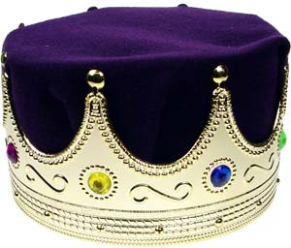
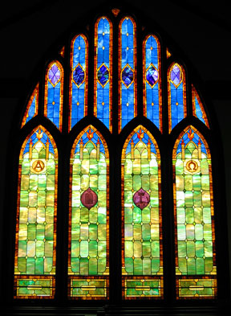
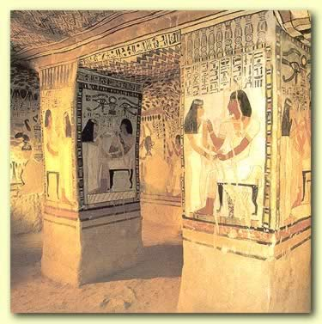
History of Colors
Colors are often symbolic
China, yellow is religious
Purple was restricted for use by nobility
Egyptians tombs adorned with brilliant colors
Christians colored
stained-glass
windows

Slide 5
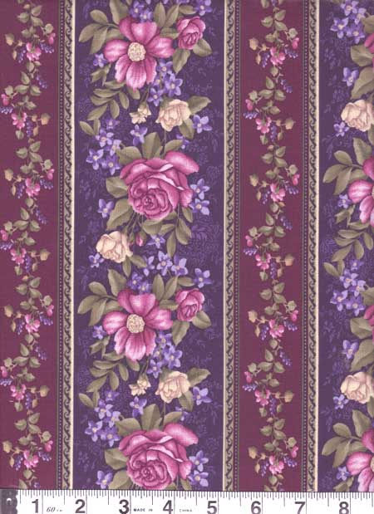
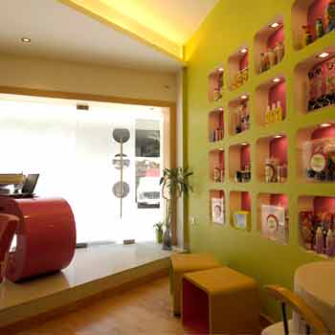
History of Color Continued ….
Victorian era referred to as the Mauve decades
20th century introduced the monochromatic room
20’s preferred all-white interiors
50’s light colors preferred
90’s are regal gold, blue, and red
What is our preferred color ….

Slide 6
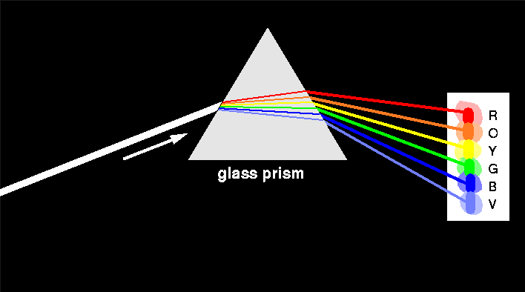
Basics about Color
A ray of light is the source of all color
Without light, color does not exist
The longest wavelength is perceived as red and the shortest as violet
Pigments are substances that can be ground into fine power and used for adding color to dyes and paints
Color can alter the appearance of form and space, affect our performance abilities, and change our moods

Slide 7
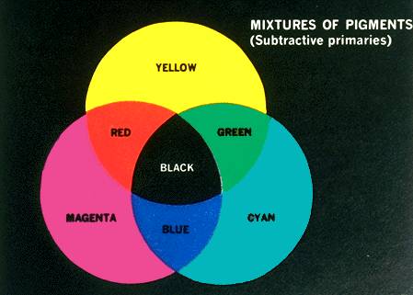
Hue
Another name for color

Slide 8
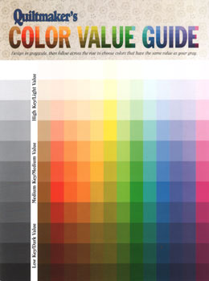
Value
Lightness or darkness of a color

Slide 9
Intensity
Brightness or dullness of a color

Slide 10
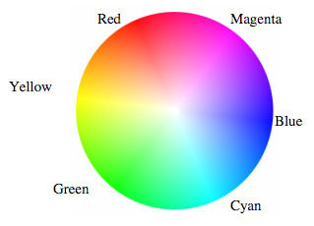
Tint
Color with white added to it

Slide 11
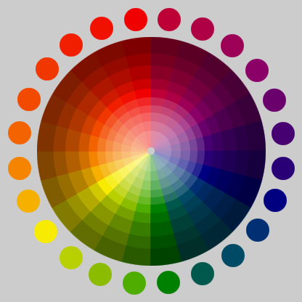
Shade
Color with black added to it

Slide 12
Hue – the name of a color
Value – the lightness or darkness of a color
Tints – values lighter than normal; adding white
Shades – values that are darker; adding black
Intensity – the purity and strength of the color
Tones – lessen add gray or the complementary color

Slide 13
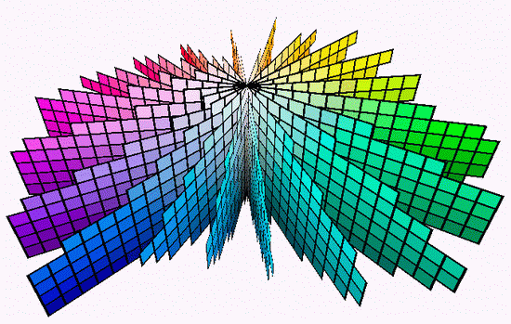
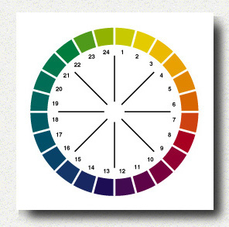
Color Systems
Munsell system
Five principal hues and five intermediate
A numbering system that helps designers identify exact hue
Ostwald system
Three pairs of complementary colors
Color circle has 24 hues

Slide 14
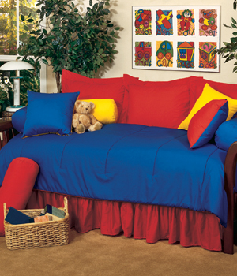
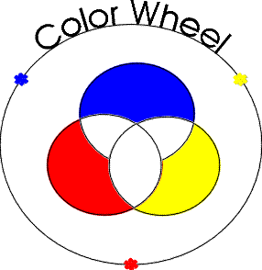
Primary: Red, Yellow & Blue

Slide 15
PRIMARY COLORS
Red
Yellow
Blue
PAINT
PAINT
PAINT

Slide 16
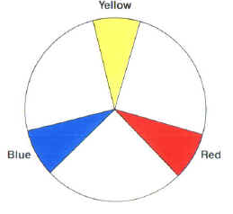
PRIMARY COLORS
http://www.fiber-images.com/Free_Things/Reference_Charts/color_wheel.htm

Slide 17
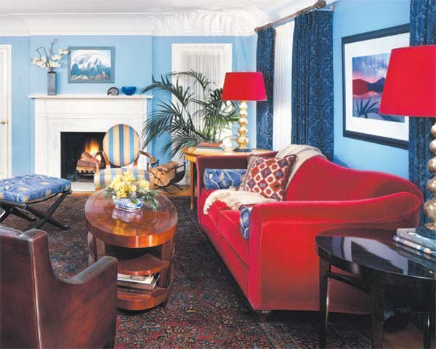

Slide 18
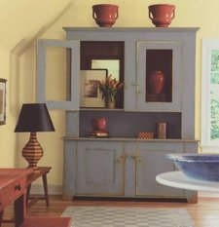

Slide 19
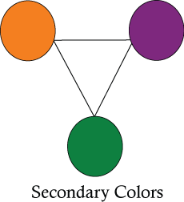
Secondary: Green, Violet, & Orange (made by combining primary colors)

Slide 20
SECONDARY COLORS
When you mix primary colors together, you get secondary colors.
PAINT
PAINT
PAINT

Slide 21
SECONDARY COLORS
YELLOW
+
BLUE
GREEN

Slide 22
SECONDARY COLORS
RED
+
BLUE
VIOLET

Slide 23
SECONDARY COLORS
YELLOW
+
RED
ORANGE

Slide 24
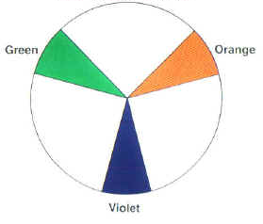
SECONDARY COLORS
http://www.fiber-images.com/Free_Things/Reference_Charts/color_wheel.htm

Slide 25
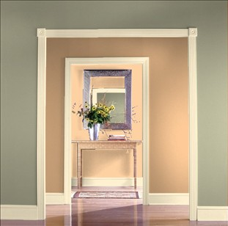

Slide 26
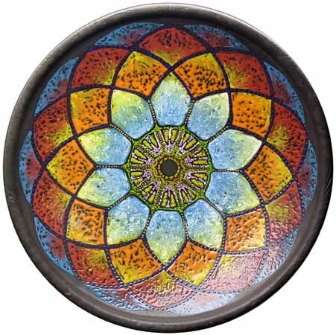
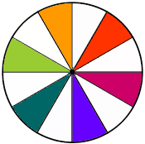
Tertiary: yellow-green, blue-green, red-violet, red-orange, and yellow-orange (made by combing secondary colors)

Slide 27
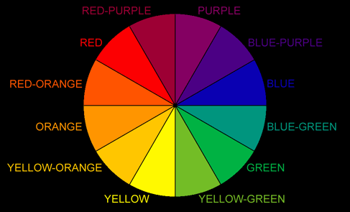
TERTIARY COLORS
When you mix primary colors with secondary colors, you get tertiary colors.
http://grace.studio-zoe.com/tuttheory.html

Slide 28
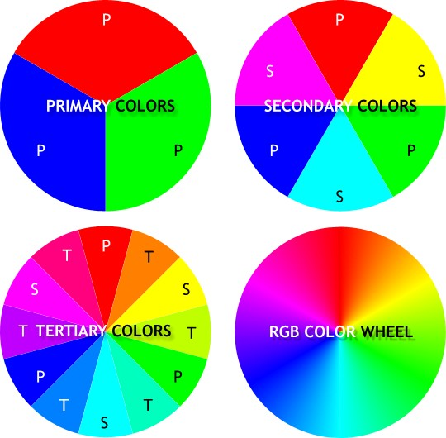

Slide 29
Color Schemes
A combination of colors selected for a room design in order to create a mood or set a tone.

Slide 30
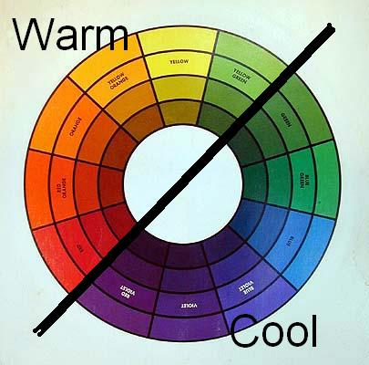
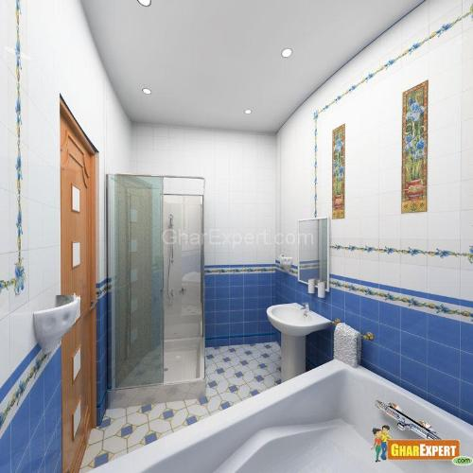
Cool Colors
Cool colors are based on blues, greens, pinks, purples, blue-greens, magentas, and blue-based reds.
Because these colors have a tendency to feel like they are receding (or backing away from you), cool tones are often used to paint the walls of a small room to make the room appear larger.

Slide 32
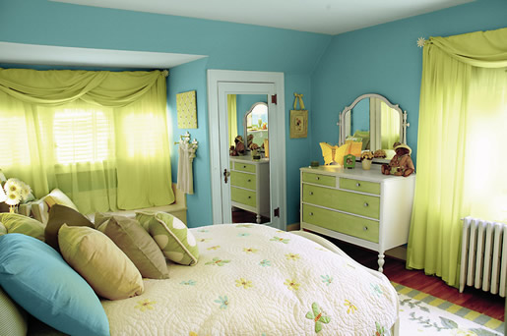
Cool Room

Slide 33
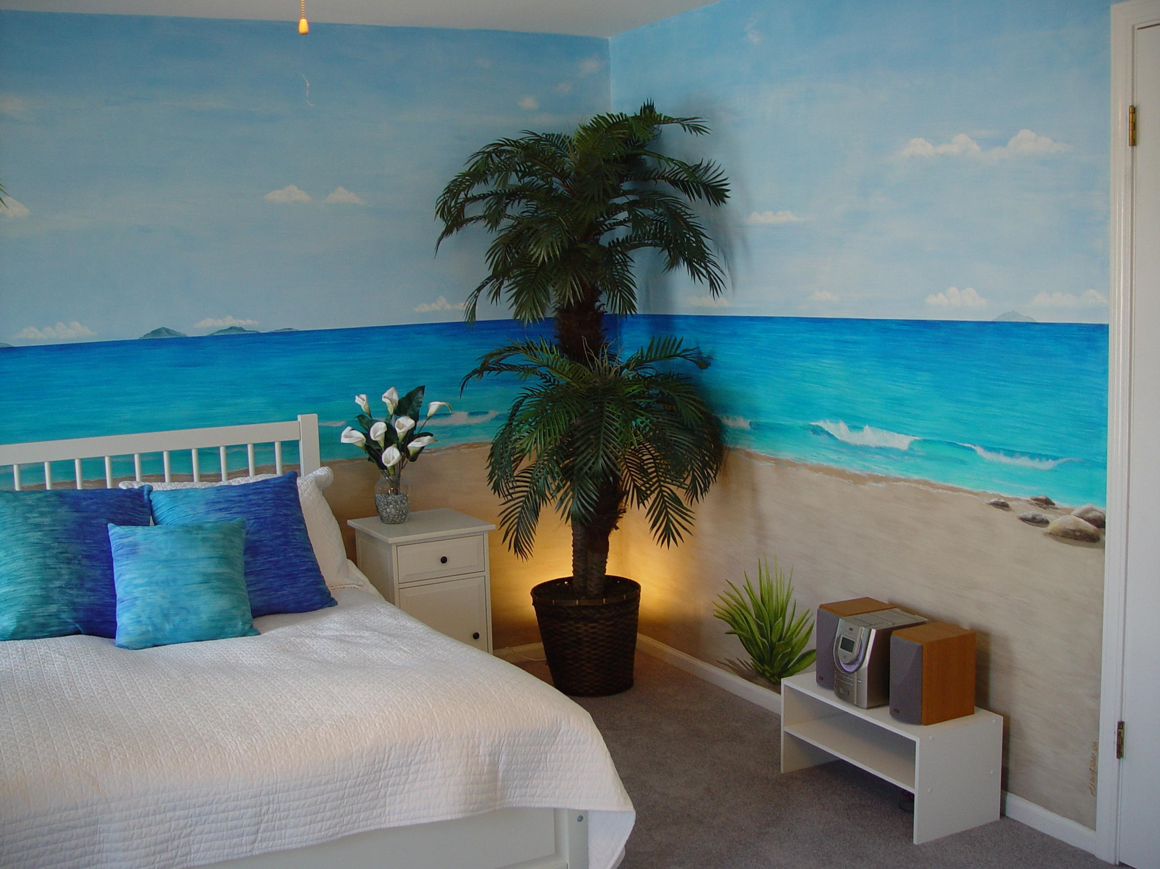

Slide 34
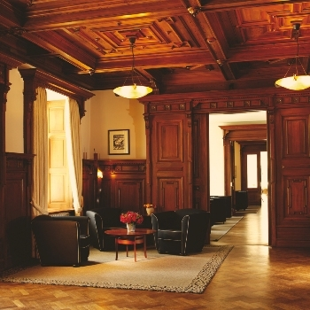
Warm Colors
Warm colors are based on yellows, oranges, browns, yellowish greens, orangish reds.
The warmth that these colors radiate tends to make them seem warm, cozy, and inviting and they draw attention very easily.
Warm colors are associated with happiness and comfort.

Slide 36
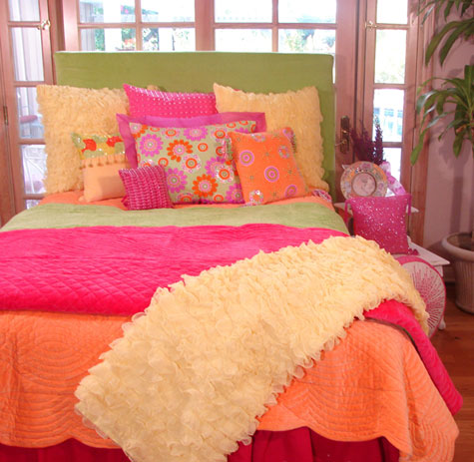
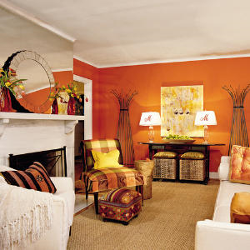
Warm Room

Slide 37
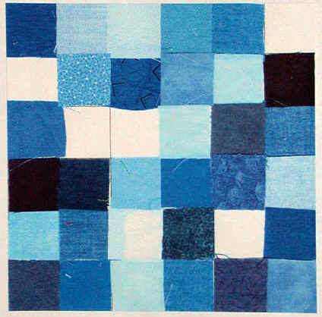
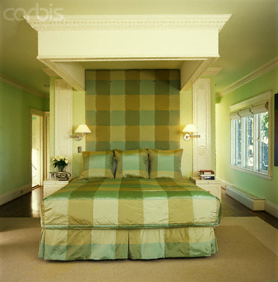
Monochromatic
A one-hue color scheme – using tints and shades
Endless values are created by adding white or black
Quiet and peaceful effect
Boredom can be avoided by using different forms, textures, and spatial relationships.

Slide 39
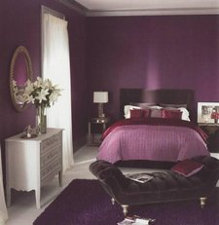
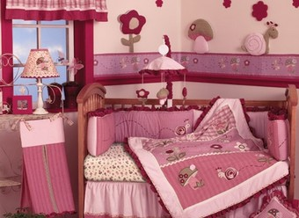

Slide 42
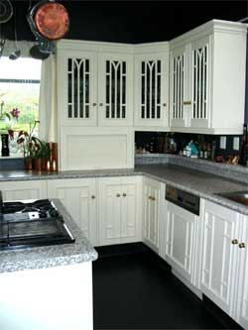
Neutral (Achromatic)
Uses no hue
Neutral colors like white, grey, and black are achromatic.
Utilizes only value variations, without intensity
Usually requires an accent color

Slide 43
• easier to live with than with vibrant color schemes.
• Often used as background colors in rooms because they blend well with other colors
• Touches of accent colors are usually added for interest
Notes:
Neutral: black white and gray (sometimes brown and beige)
White: totally absent of color
.give increased visual space
.whitened backgrounds look light, spacious, and farther away
.Hues seem cleaner and crisper when surrounded by white
Black: mixture of all colors
.sharpens and adds richness to the hues placed next to it
.used generously may create a dramatic and theatrical setting
.Accents give richness
Gray: combination of black and white
.warm grays–welcoming and comforting
.cool grays–tend to be cold and uninviting
Browns: mixing several colors on the color wheel or neutralizing orange
.Often introduced through stained woods
.Does not need to match as long as they harmonize
.If used in large amounts can create an oppressive or cave-like coziness

Slide 44
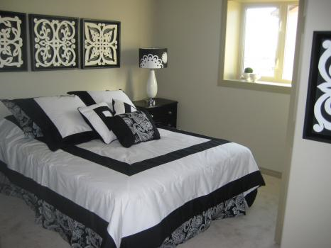

Slide 47
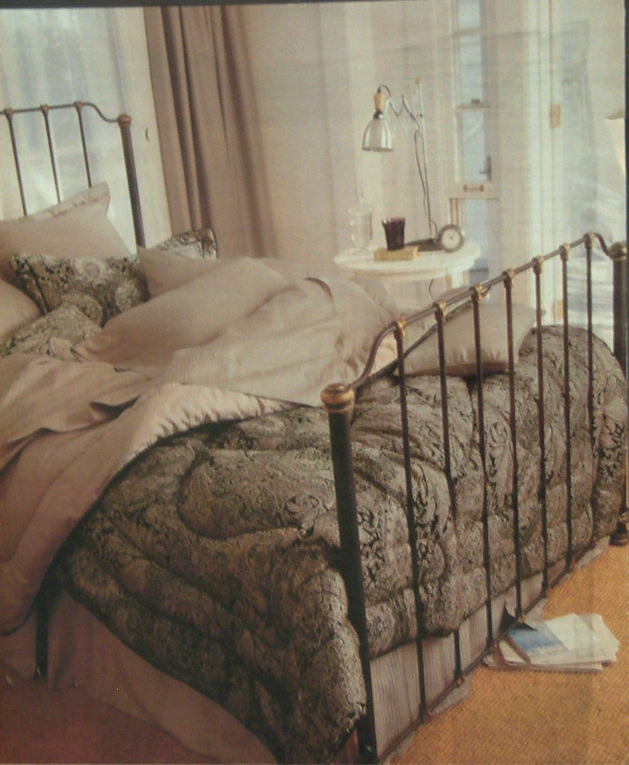

Slide 48
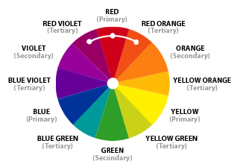
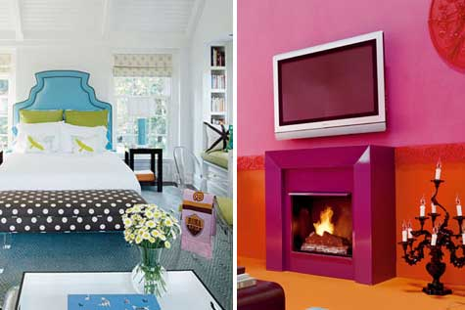
Analogous
Uses colors (3-5) that are adjacent to each other on the color wheel.
One color is used as a dominant color while others are used to enrich the scheme

Slide 49
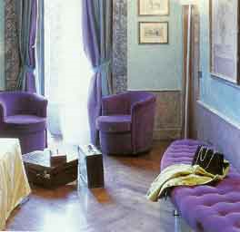
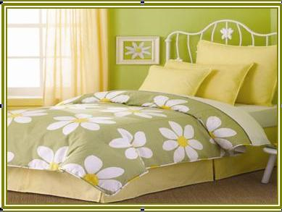
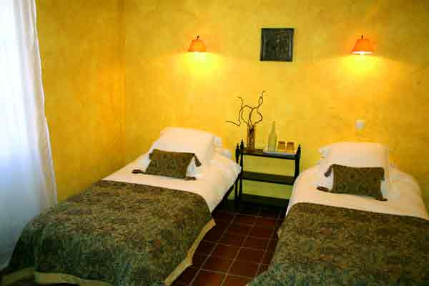

Slide 53
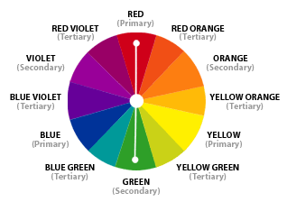
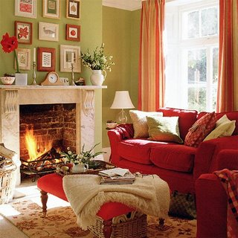
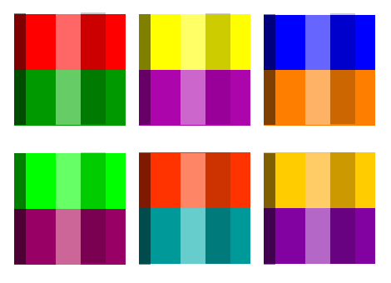
Complementary
Built by combining hues opposite each other on the color wheel
Tend to be livelier than other schemes
Values and intensities must be handled carefully

Slide 54
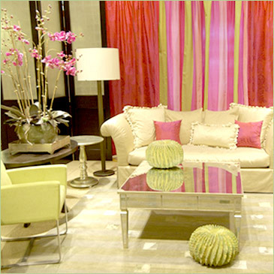
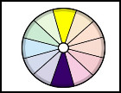
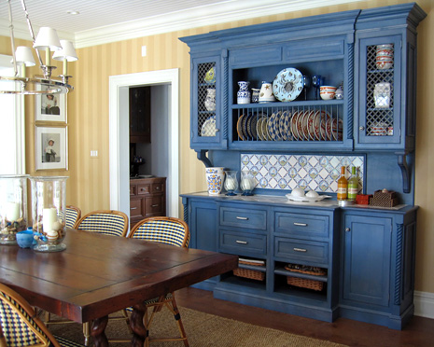
Complementary

Slide 55
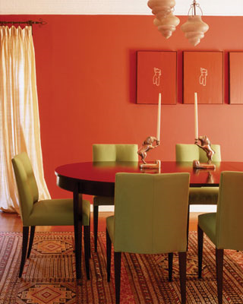

Slide 59
Split-Complementary
A variation of the standard complementary scheme
Uses a color and the two colors adjacent to its complementary
Provides high contrast without the strong tension of the complementary scheme

Slide 61
Triadic
When three colors, evenly spaced from one another, are used.
The triadic scheme is not as contrasting as the complementary scheme, but it looks more balanced and harmonious

Slide 68
What happens if you have no color scheme?

